Slide 1
Summer Slam
Warm Water Patterns and Techniques
Captain Greg Peralta
www.captgregp.com
@captgregp
captgregp@gmail.com

Slide 2
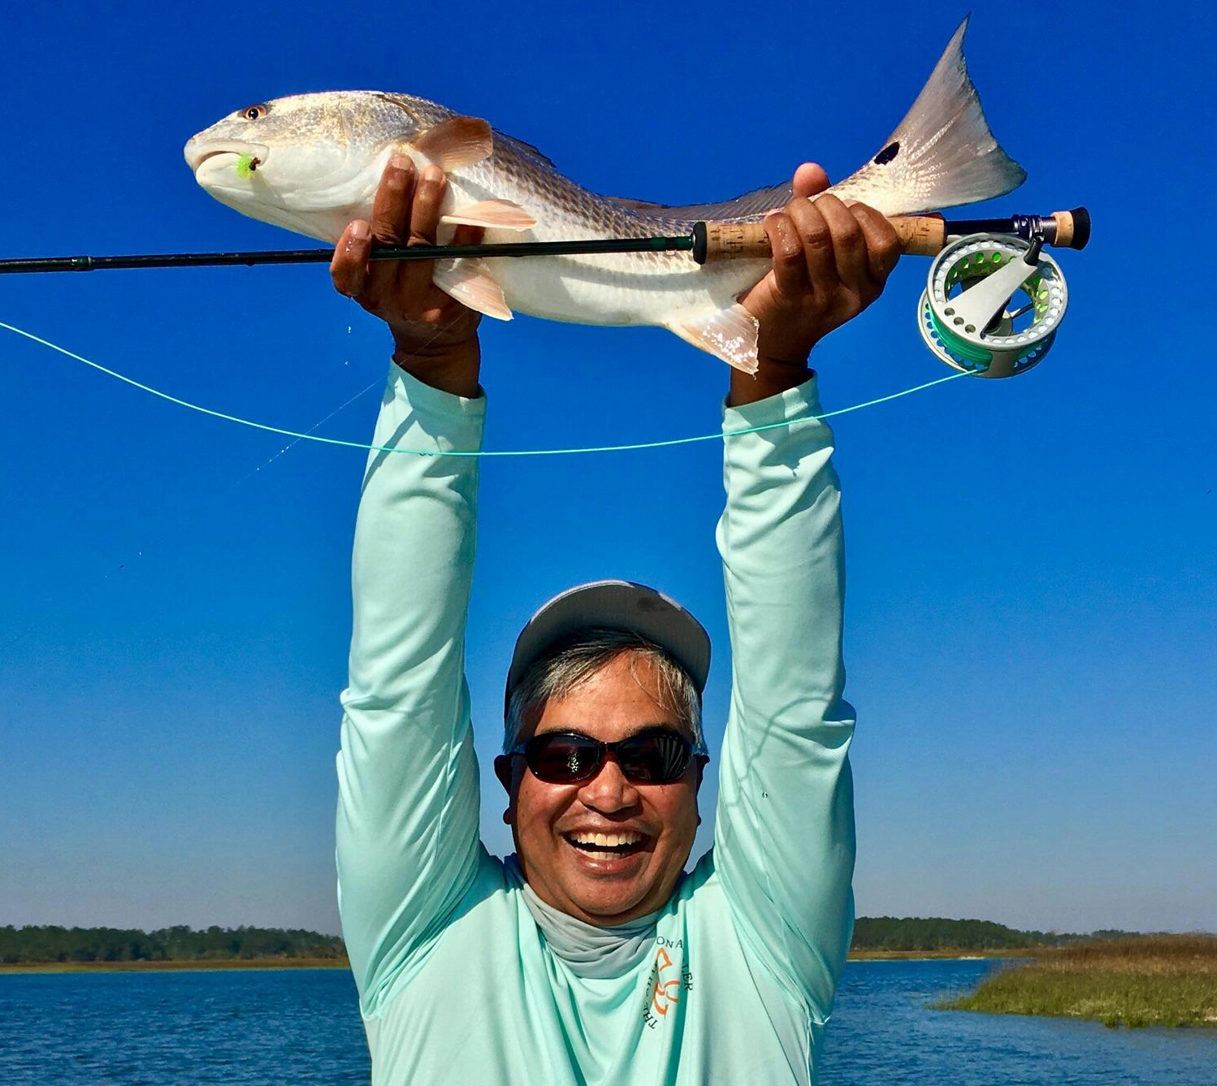
About Me
Retired from guiding several year ago
Still fish 3-5 times per week
No Pressure
Experiment
Lures
Techniques
Share
Articles
Blog
Events

Slide 3
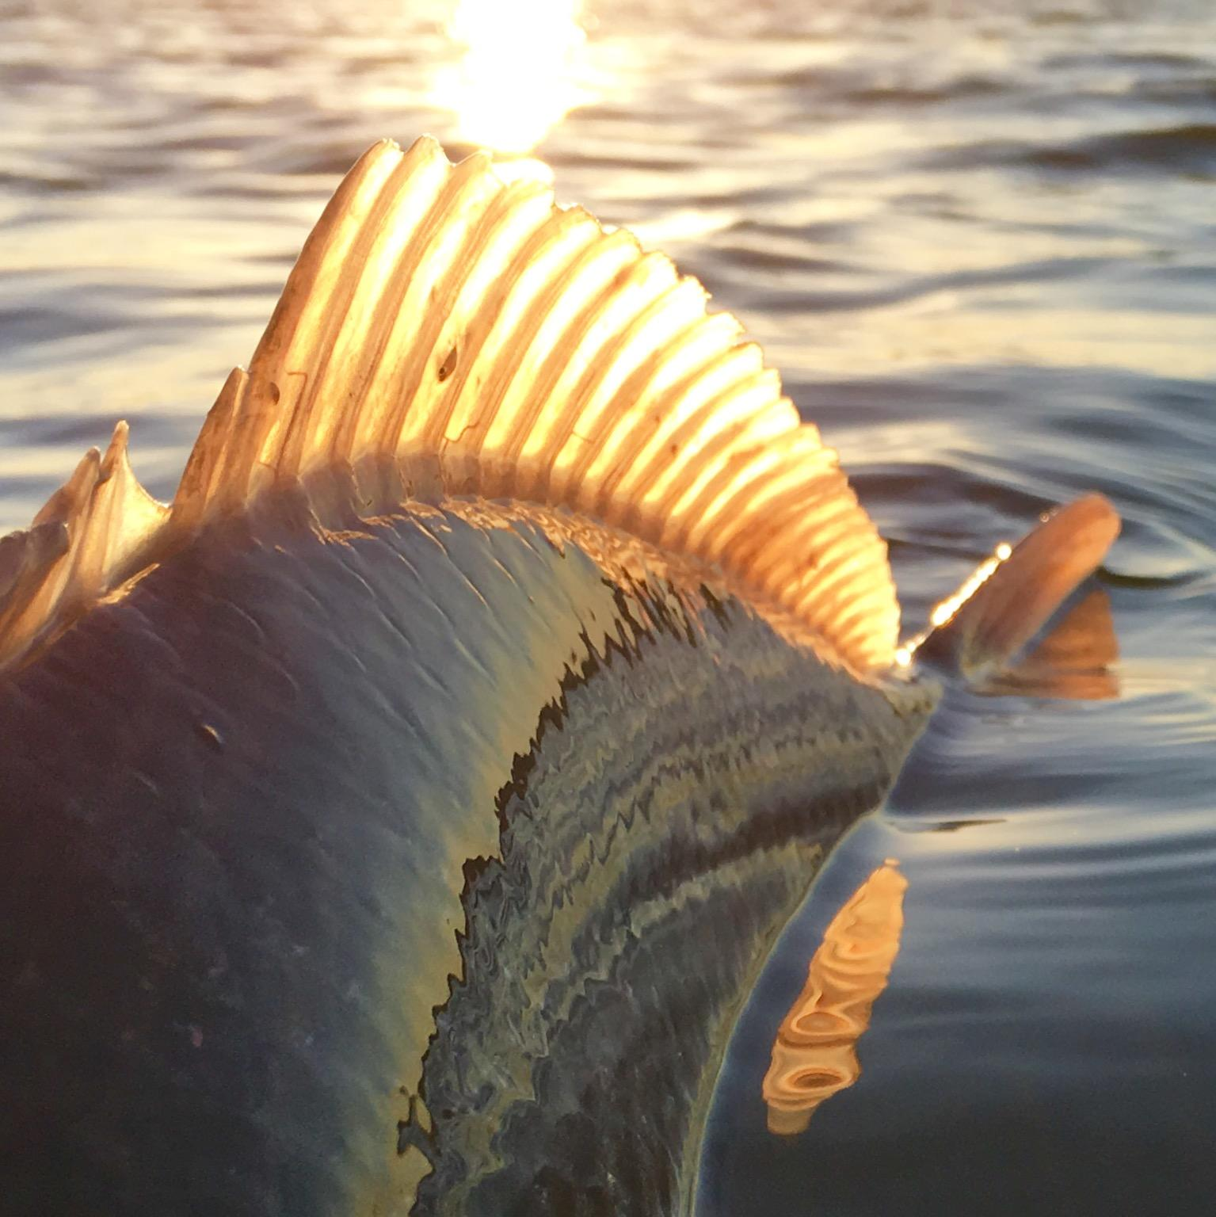
Summer Slam
Feeding Behavior
Location / Pattern
Structural elements
Depth transition
Current
Clarity
Water column
Tackle
Lures
Techniques
Q&A

Slide 4
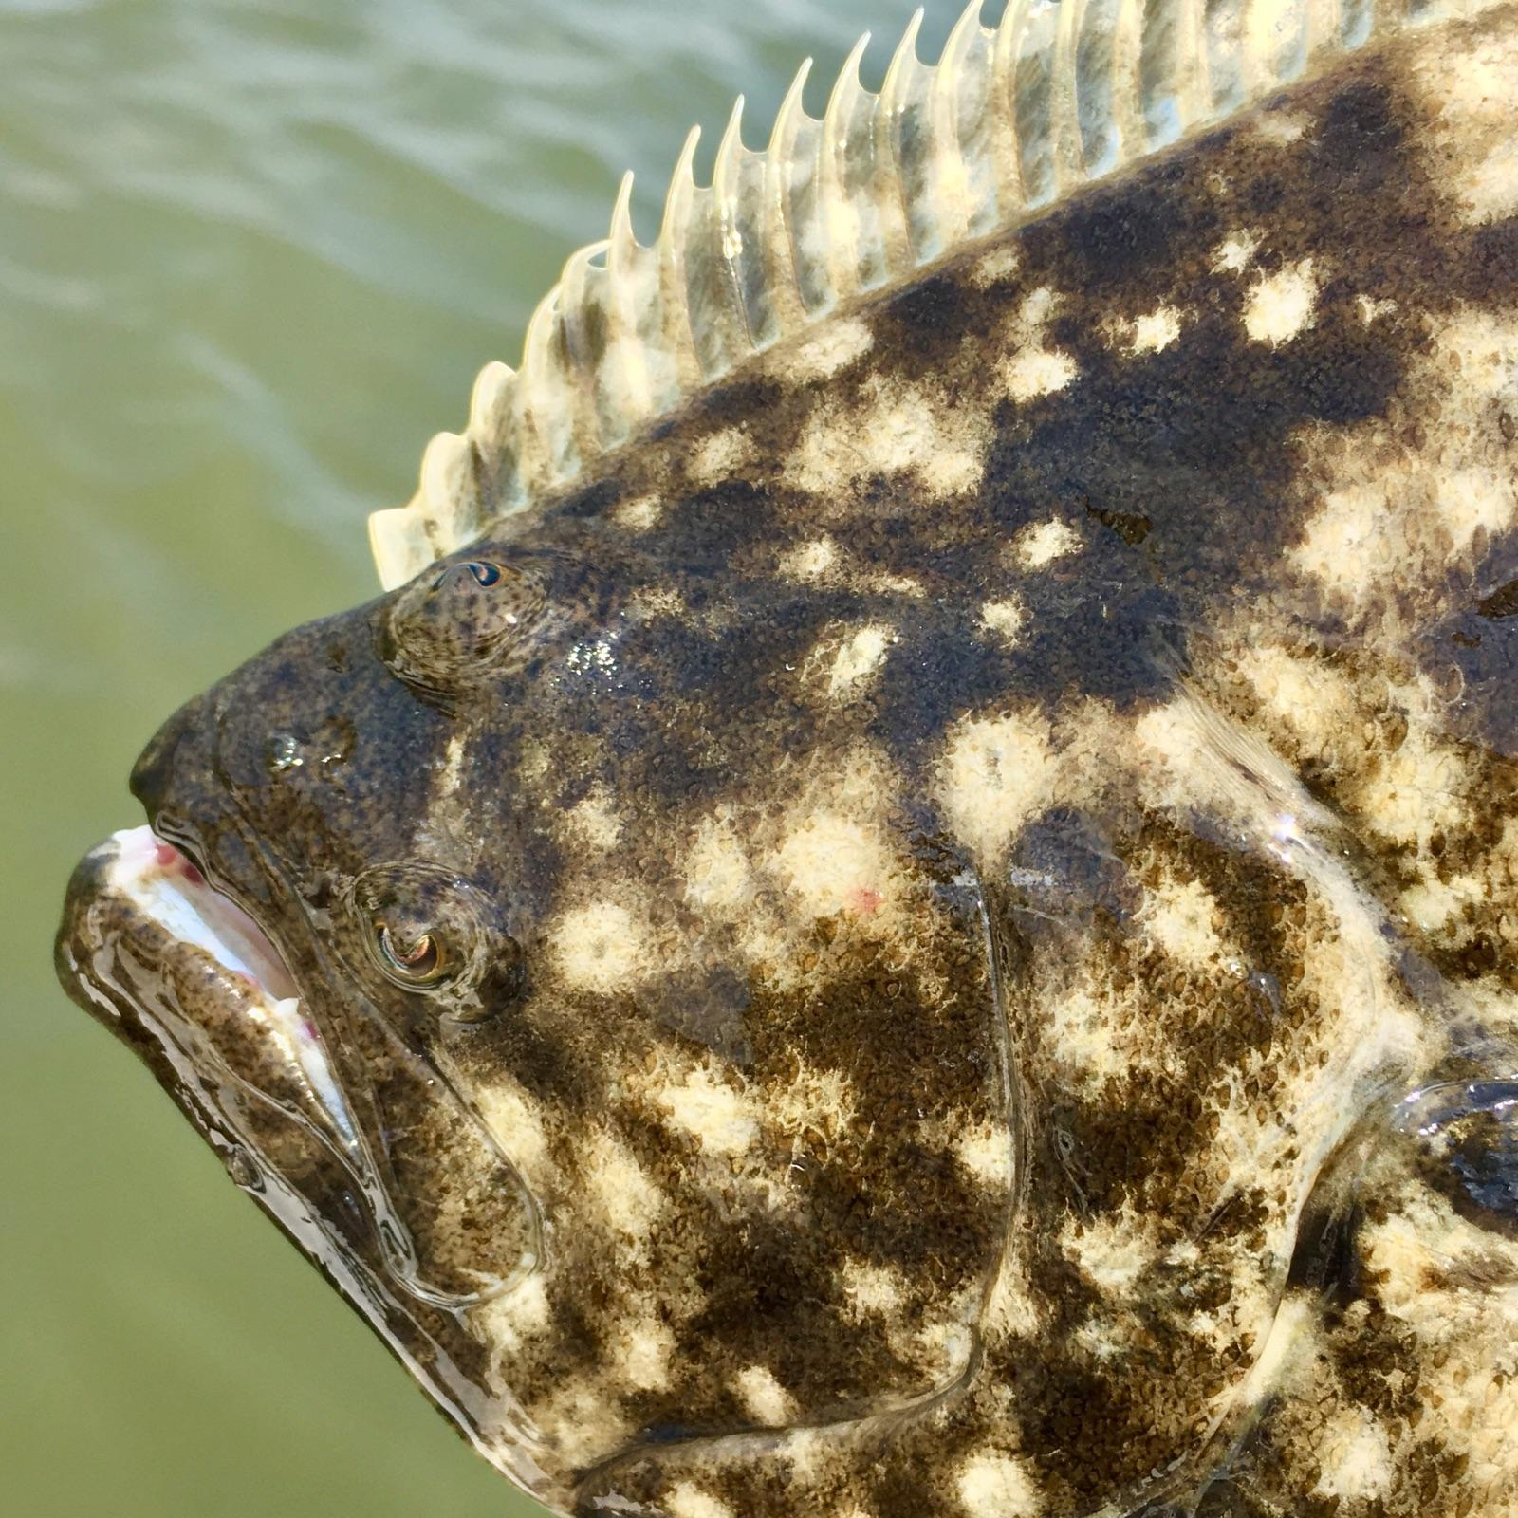
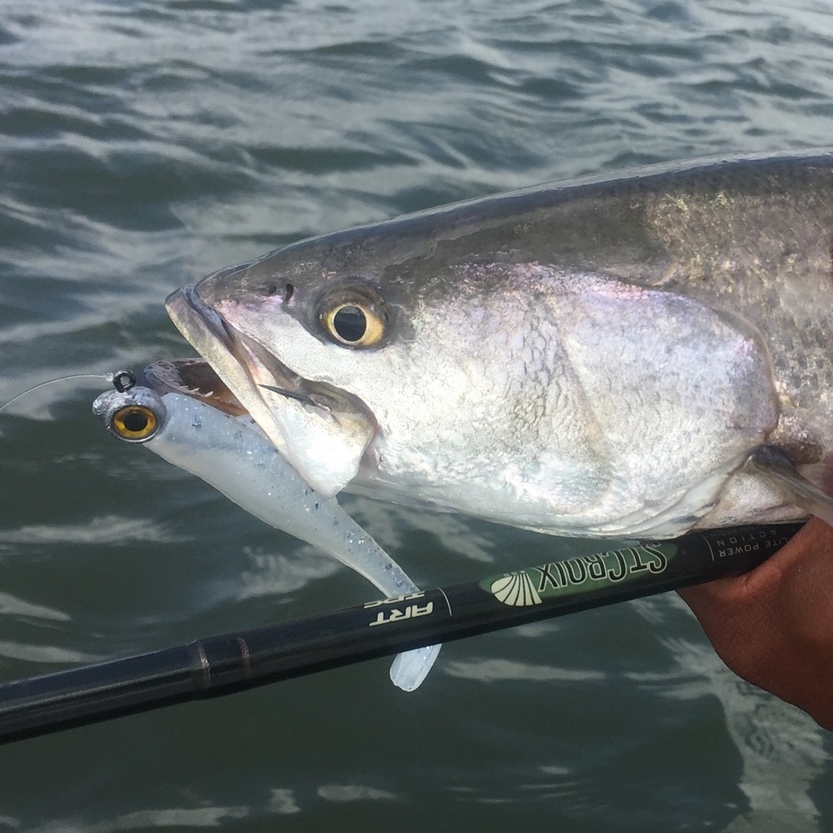
Feeding Behavior

Slide 5
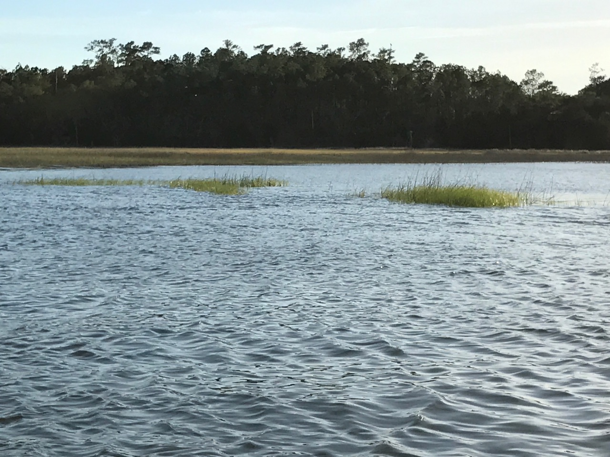
Location / Pattern
Structural elements
Marsh points
Oyster bars
Depth transition
Current
Clarity
Collect baitfish
Attracts predators

Slide 6
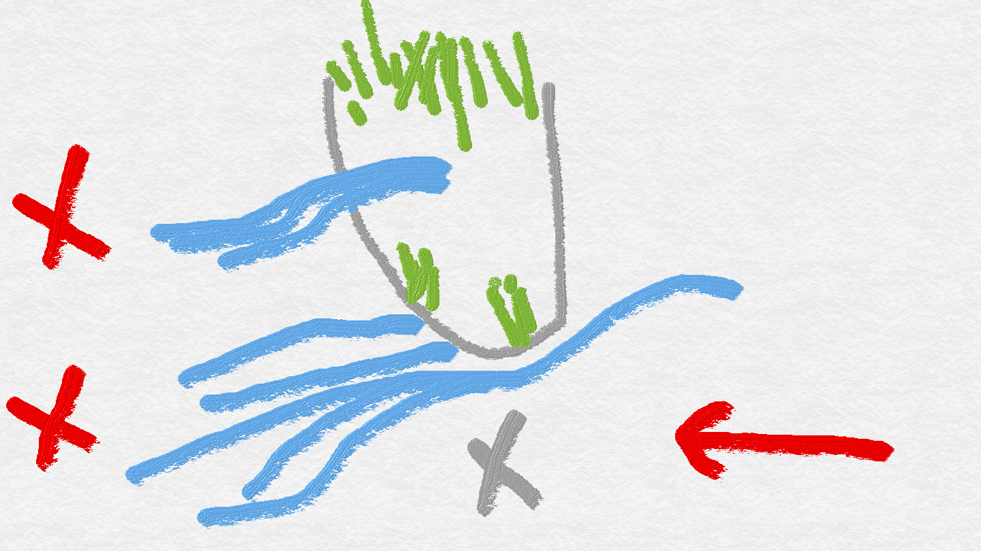
Visualize and Adjust
Structure
Depth transition
Current
Fish position
Strike zone
Boat position

Slide 7
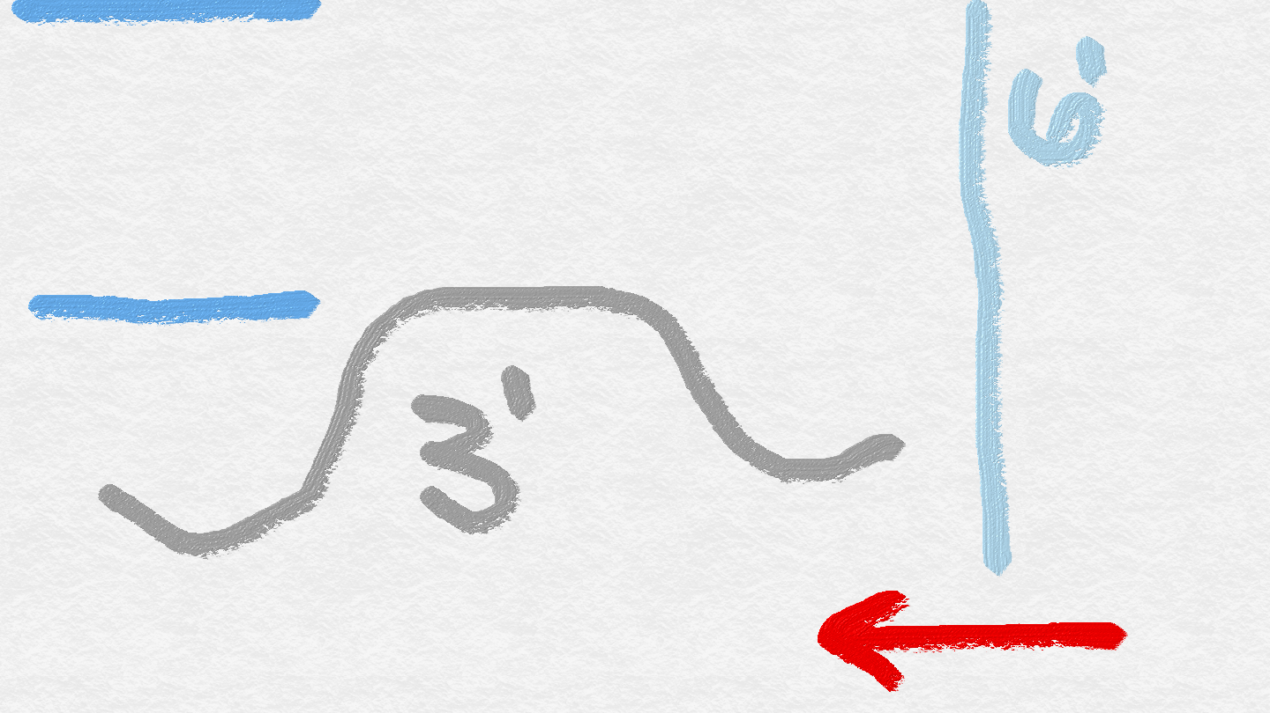
Water Column Diagram
Tidal stage
Depth transition
Current
Species
Lower
Redfish
Flounder
Upper
Trout
Ladyfish
Bluefish
Milk run
1 foot
2 feet
3 feet
Productive area all day long

Slide 8
Tackle
Favorite
St. Croix Legend Elite 7’ fast action L
Shimano 1000 frame CI4
3/16 ounce or less
All round
St. Croix Legend Elite 7’ fast action ML
Shimano 2500 frame CI4
1/4 ounce
PowerPro 10/2 high visibility braid with #12 fluorocarbon leader
Knot system
Weight and balance matter

Slide 9
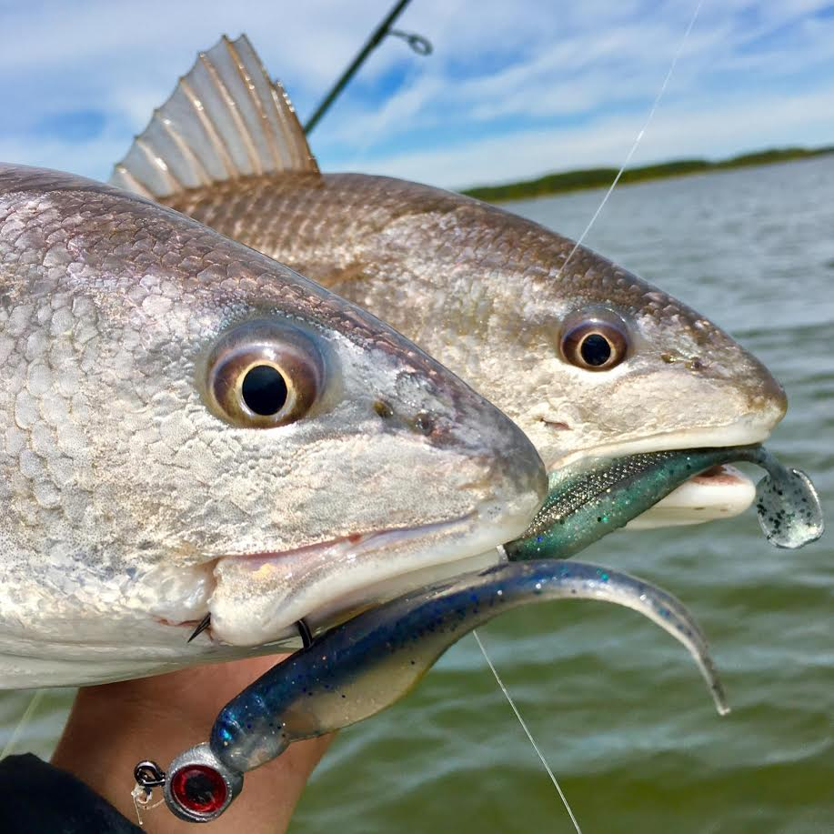
Lures
Rate of Descent
Action
Upper
Z-Man StreakZ 3.75 on 2/0 1/16 ounce flutter hook
Z-Man StreakZ on 4/0 1/16 ounce flutter hook
Lower
Z-Man StreakZ 3.75 on 2/0 3/16 ounce Trout Eye finesse jig
Z-Man MinnowZ on 3/0 1/4 ounce jig

Slide 10
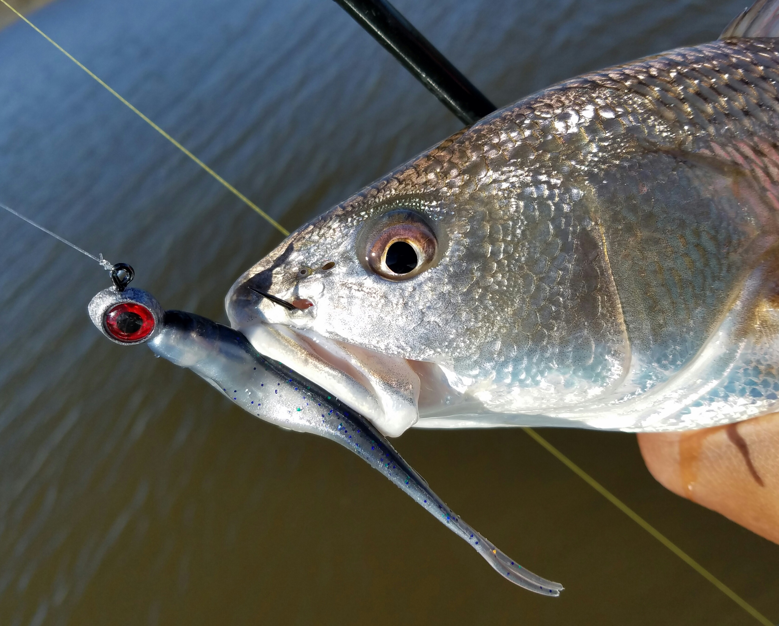
Retrieve Techniques
Aquarium 101
Buoyancy control
Out of sync (erratic) movement
Reaction strike
Upper
Sweep and swim
Lower
Sweep and swim
Hop and stop
Jiggly wiggly

Slide 11
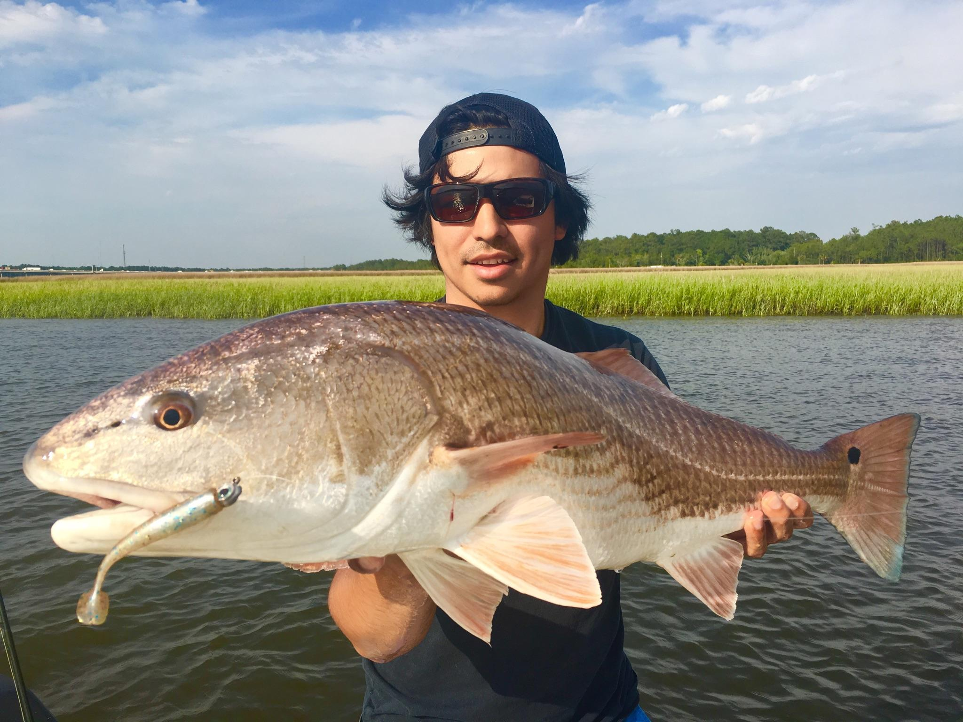
Q&A

Slide 12
Summer Slam
Warm Water Patterns and Techniques
Captain Greg Peralta
www.captgregp.com
@captgregp
captgregp@gmail.com

